Slide 1
Chapter 3-Spectrum and Bandwidth

Slide 2
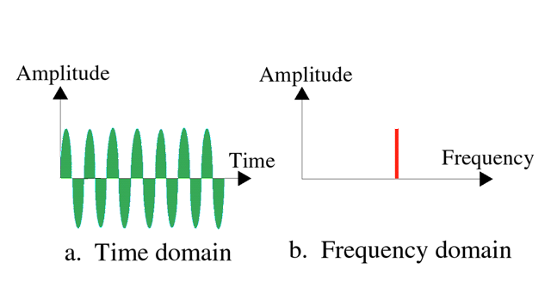
Time and frequency domains
The time-domain plot shows changes in signal amplitude with respect to time (it is an amplitude-versus-time plot).
A frequency-domain plot is concerned with only the peak value and the frequency. Changes of amplitude during one period are not shown.

Slide 3

Time and frequency domains

Slide 4
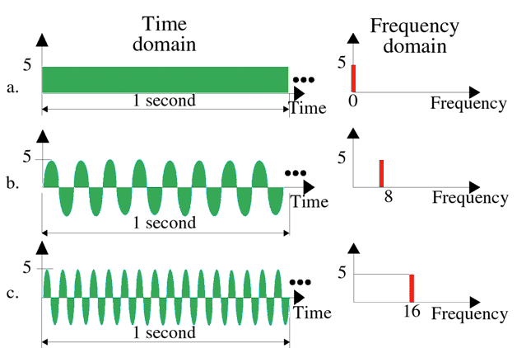
Time and frequency domains

Slide 5

Time and frequency domains
The frequency domain is more compact and useful when we are dealing with more than one sine wave.
A single-frequency sine wave is not useful in data communication. We need to send a composite signal, a signal made of many simple sine waves.

Slide 6
Fourier Analysis
According to Fourier analysis, any composite signal is a combination of simple sine waves with different frequencies, amplitudes, and phases.
Composite Signals
A composite signal can be periodic or nonperiodic.
A periodic composite signal can be decomposed into a series of simple sine waves with discrete frequencies, frequencies that have integer values (1, 2, 3, and so on).
A nonperiodic composite signal can be decomposed into a combination of an infinite number of simple sine waves with continuous frequencies, frequencies that have real values.

Slide 7
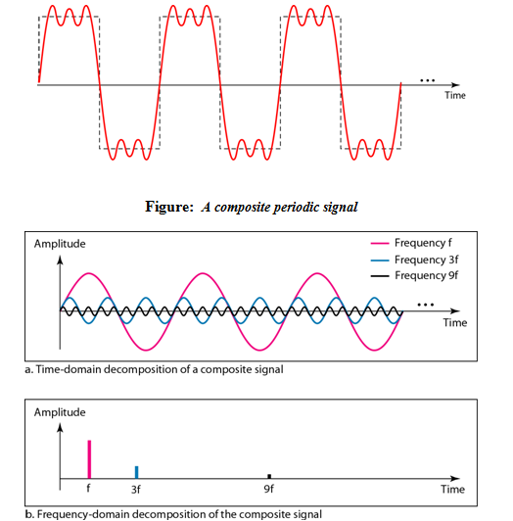
Fourier Analysis
Decomposition of the composite periodic signal in the time and frequency domains

Slide 8
Periodic composite signal
The amplitude of the sine wave with frequency f is almost the same as the peak amplitude of the composite signal. As the frequency of the composite signal is same as the frequency of this signal so it is called fundamental frequency or first harmonic.
The amplitude of the sine wave with frequency 3f is one third of the first frequency. As the frequency is 3 times of the first frequency so it is 3rd harmonic.
The amplitude of the sine wave with frequency 9f is one ninth of the first frequency. As the frequency is 9 times of the first frequency so it is 9th harmonic.
Frequency can not be 1.2f or 2.6f

Slide 9

Time and frequency domains of a nonperiodic signal
A nonperiodic composite signal can be a signal created by a microphone or a telephone set.
In this case, the composite signal cannot be periodic because that implies that we are repeating the same word or words with exactly the same tone.

Slide 10

Bandwidth
The bandwidth of a composite signal is the difference between the highest and the lowest frequencies contained in that signal.

Slide 11

Example
A nonperiodic composite signal has a bandwidth of 200 kHz, with a middle frequency of 140 kHz and peak amplitude of 20 V. The two extreme frequencies have amplitude of 0. Draw the frequency domain of the signal.
Solution
The lowest frequency must be at 40 kHz and the highest at 240 kHz.
The bandwidth of a composite signal is the difference between the highest and the lowest frequencies contained in that signal.

Slide 12


Example
A periodic signal is decomposed into five sine waves with frequencies of 100, 300, 500, 700, and 900 Hz, what is its bandwidth? Draw the spectrum, assuming all components have a maximum amplitude of 10 V.
Solution
Let f_{h} be the highest frequency, f_{l} the lowest frequency, and B the bandwidth. Then
.
The spectrum has only five spikes, at 100, 300, 500, 700, and 900 Hz .

Slide 13

Example
A periodic signal has a bandwidth of 20 Hz. The highest frequency is 60 Hz. What is the lowest frequency? Draw the spectrum if the signal contains all integer frequencies of the same amplitude.
Solution
Let f_{h} be the highest frequency, f_{l} the lowest frequency, and B the bandwidth. Then
The spectrum contains all integer frequencies. We show this by a series of bars.

Slide 14
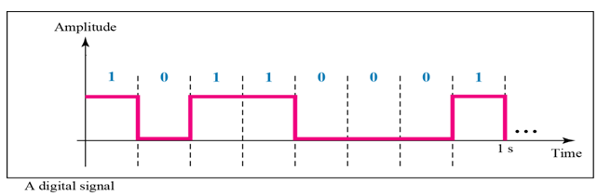
Digital Signals
In addition to being represented by an analog signal, information can also be represented by a digital signal.
For example, a 1 can be encoded as a positive voltage and a 0 as zero voltage.
A digital signal can have more than two levels. In this case, we can send more than 1 bit for each level.

Slide 15
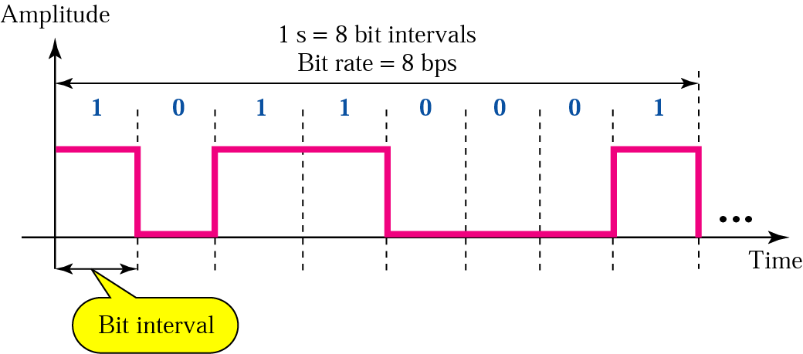
Bit Interval and Bit Rate
Most digital signals are aperiodic and thus period or frequency is not appropriate.
Two new terms, bit interval(instead of period) and bit rate (instead of frequency) are used to describe digital signals.
The bit interval is the time required to send one single bit.
The bit rate is the number of bit intervals per second. This means that the bit rate is the number of bits sent in one second, usually expressed in bits per second (bps).

Slide 16
Bit Interval and Bit Rate
Example
A digital signal has a bit rate of 2000 bps. What is the duration of each bit (bit interval)
Solution
The bit interval is the inverse of the bit rate.
Bit interval = 1/ 2000 s = 0.000500 s
= 0.000500 x 10⁶ microsec = 500 microsec

Slide 17

Example
Two digital signals: one with two signal levels and the other with four signal levels

Slide 18
Example
A digital signal has 8 levels. How many bits are needed per level?
Solution:
We calculate the number of bits from the formula
Each signal level is represented by 3 bits.

Slide 19
Example
A digital signal has 9 levels. How many bits are needed per level?
Solution:
Each signal level is represented by 3.17 bits.
The number of bits sent per level needs to be an integer as well as a power of 2.
Hence, 4 bits can represent one level.

Slide 20

The time and frequency domains of periodic and nonperiodic digital signals

